Slide 1

S4
Simple and Secure storage service
Kamran Karimov
Elza Gurbanova

Slide 2
Agenda
What is S4?
Why S4 project is developed
How S4 works?
Quick live demo

Slide 3
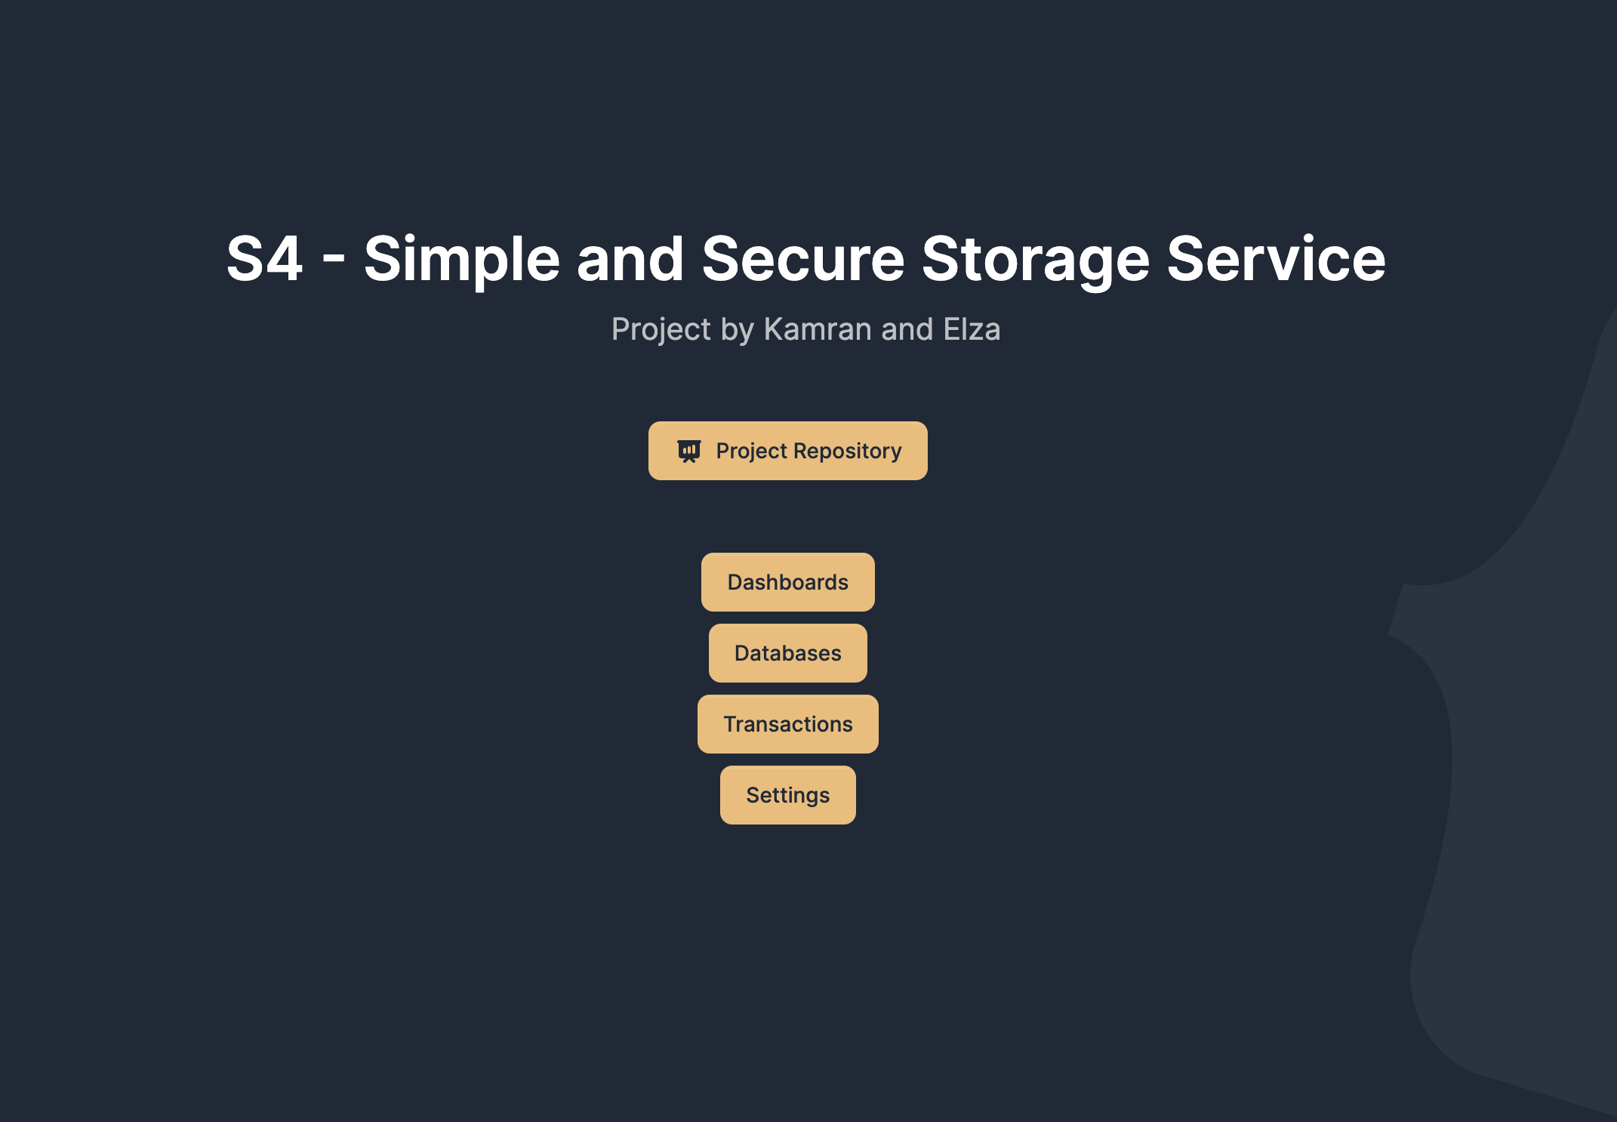
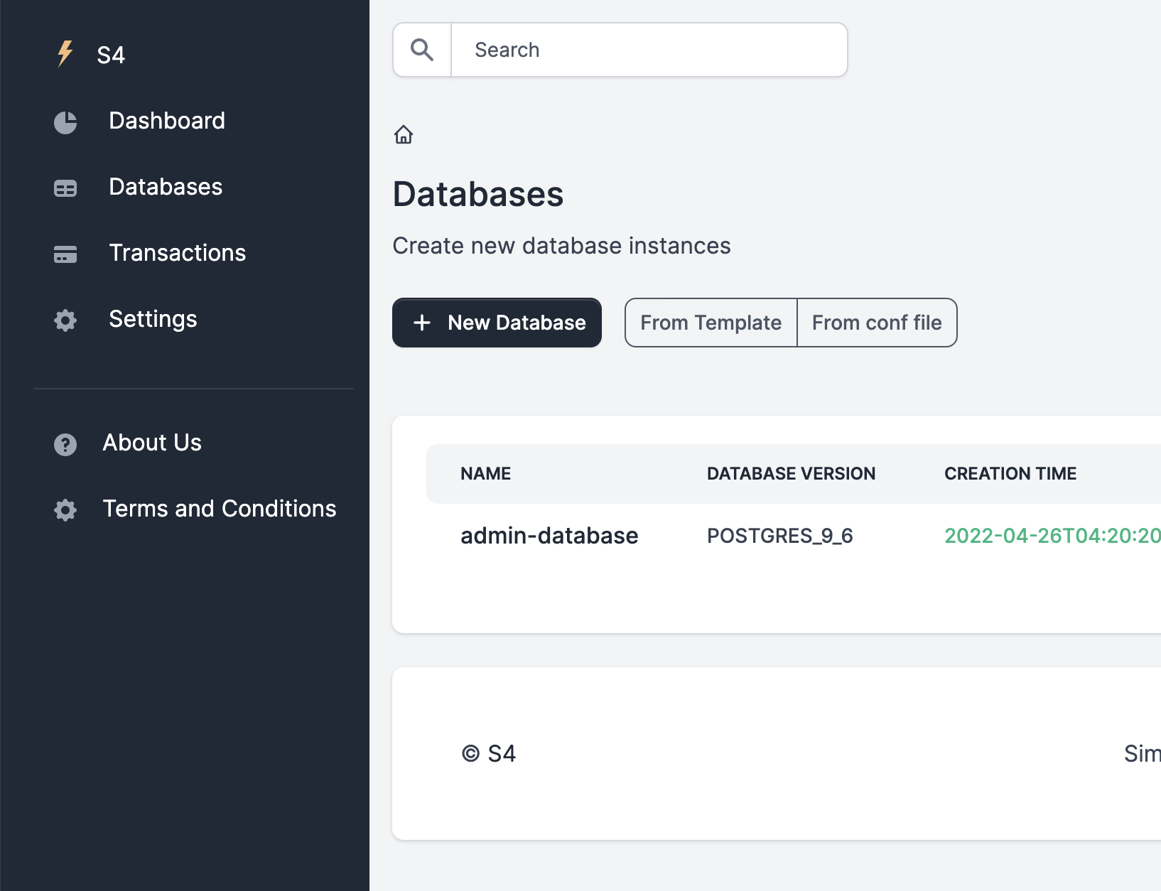
S4 is Database-as-a-Service(DAAS) provider

Slide 4
Cloud providers in Azerbaijan? yer.az azcloud.az Number of DAAS platforms in Azerbaijan? 0

Slide 5
How S4 works
Register in S4
Login
Fill in database creation form
Wait a few minutes
Take public ip of database instance and that is it!

Slide 6
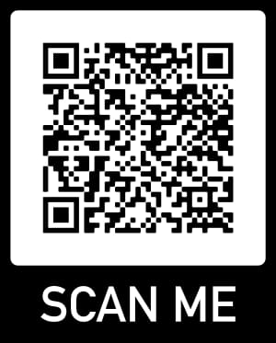
Try It!
https://s4-app-dtpokso7oq-uc.a.run.app/

Slide 7
Thank you
Elza Gurbanova
Kamran Karimov
2022

